Slide 1
06 | Introduction to Bootstrap
Susan Ibach | Technical Evangelist
Christopher Harrison | Content Developer

Slide 2
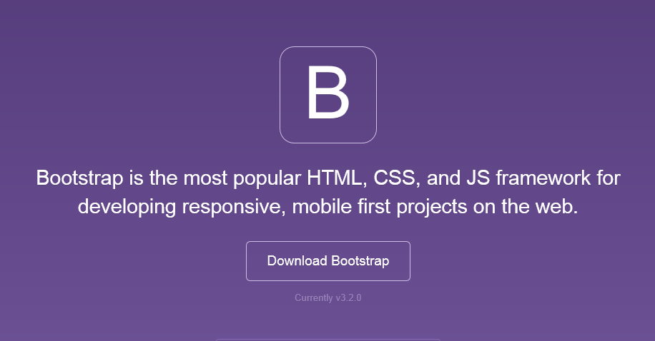
Bootstrap
The most popular front-end framework for developing responsive, mobile first projects on the web.

Slide 3
Why bother with Bootstrap?
CSS can be tricky
Cross browser support can be a challenge
Solves basic tasks (e.g. page layout without tables)

Slide 4
What does Bootstrap offer?
Theme Support
Responsive
Grid
Components
Pagination
Buttons
Modal
Great Visual Studio support

Slide 5
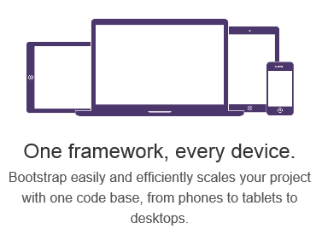
You keep saying "responsive". What does that mean?

Slide 6
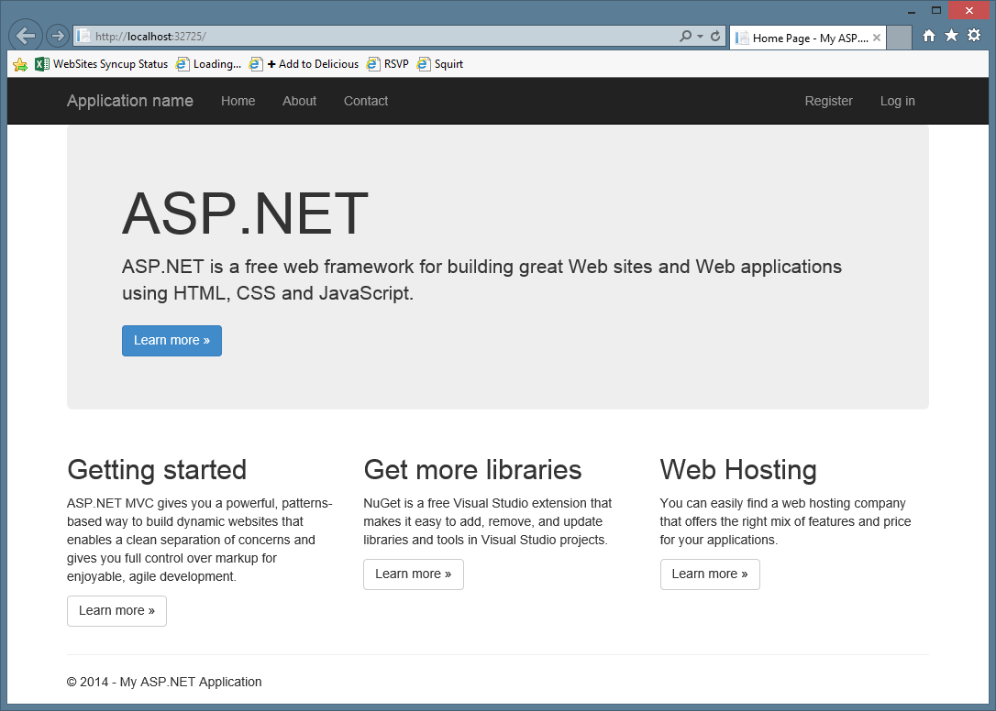
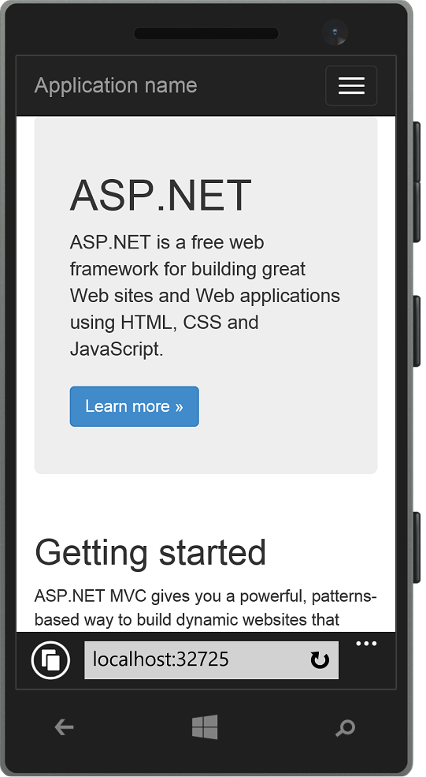
Responsive layout examples

Slide 7
Theme Support
I don't like the default colors. Can I change them?

Slide 9
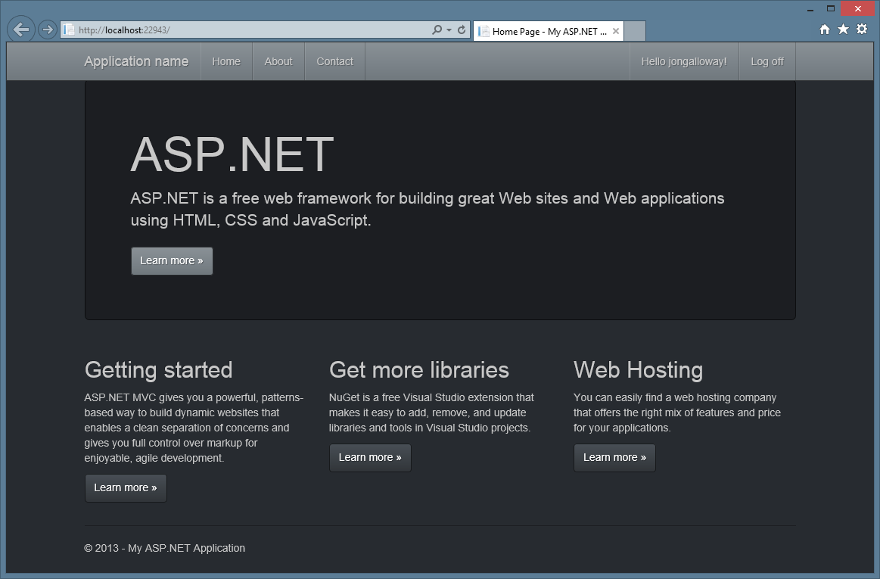

Slide 10
Customizing the theme

Slide 11
Grid System
How do I lay pages out?

Slide 12
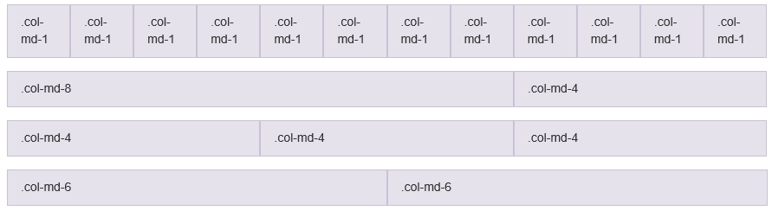
Sizing your content

Slide 13
Four grids to rule them all One for each size of device
Large (lg)
Medium (md)
Small (sm)
Extra Small (xs)

Slide 14
Frequently asked column questions
Is there always twelve columns?
Yes
Why twelve?
The goal was to make it easy to size content while giving you enough control over your layout
Can I change the number of columns?
Technically, yes. But don't.

Slide 15
What about containers?
Bootstrap offers both container and container-less displays
Container-less will take up the entire screen
Container will contain your data in a, well, container
Content will be contained in here
The container will always stay the
same size for the screen size

Slide 16
Grid system
 | Extra small devices Phones (<768px) | Small devices Tablets (≥768px) | Medium devices Desktops (≥992px) | Large devices Desktops (≥1200px)
Grid behavior | Horizontal at all times | Collapsed to start, horizontal above breakpoints
Container width | None (auto) | 750px | 970px | 1170px
Class prefix | .col-xs- | .col-sm- | .col-md- | .col-lg-
Column width | Auto | 60px | 78px | 95px
Gutter width | 30px (15px on each side of a column)

Slide 17
Grids and containers
Notes:
Christopher - Grid

Slide 18
Visual Studio support

Slide 19
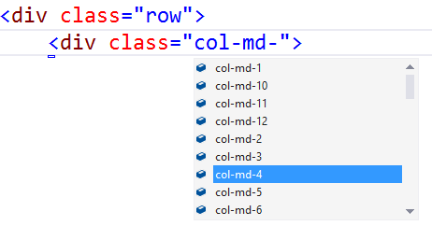
Visual Studio – Class IntelliSense

Slide 20
Visual Studio Bootstrap Snippets

Slide 21
Bootstrap forms

Slide 22
Bootstrap Forms
HTML5 provides rich functionality
New types of inputs
Placeholders
Bootstrap defaults
Vertical display
Focus highlighting
Easy to customize

Slide 23
Form Classes
Need to add classes to introduce functionality
Main classes
form-group
form-control

Slide 24
Question submission form

Slide 25
Bootstrap Resources
www.getbootstrap.com
www.bootswatch.com
Bootstrap snippets

Slide 26
What did we learn today?
Advanced layouts in Jinja
How to use a relational database
A bit of Bootstrap
Object oriented design

Slide 27
Where do we go now?
For your growth
What interested you the most?
For a deeper understanding
What can we do with the app?

Slide 28
Data design MVAs
Redis
SQL Server
MongoDB

Slide 29
Front end design
Bootstrap
CSS

Slide 30
Back end design
C# fundamentals for absolute beginners
Introduction to MVC

